Slide 1
PROJECT
Study site(WEBSITE)
Name:-SHUBHAM
CLASS:-k2-g1
UID:-18BCS1059
Mentor:- Mrs. Arshleen

Slide 2
Project Overview
As we already know that as the world is advancing toward a totally new and technological advance era therefore competition around the world is increasing at an incredible rate but still lack of information and resources is a major concern these days therefore this website provide information and study material about the 12 class and competative courses in order to help parents, children and teachers to access the most famous websites from a single website and achieve success

Slide 3
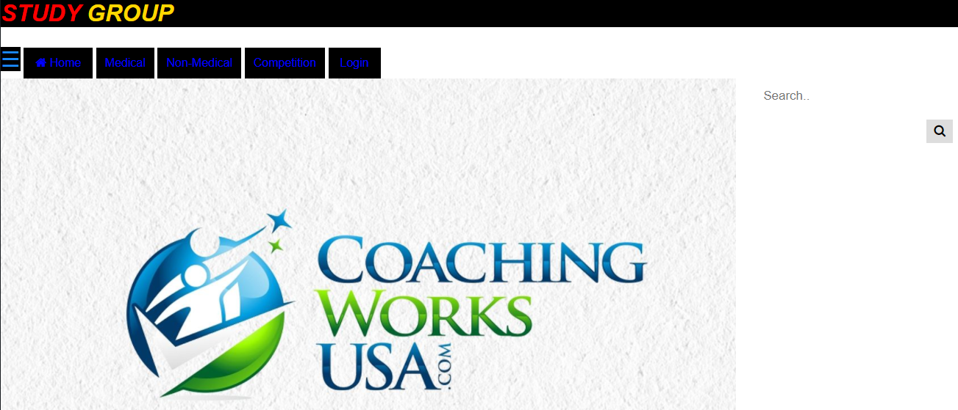
Project Snapshots

Slide 4
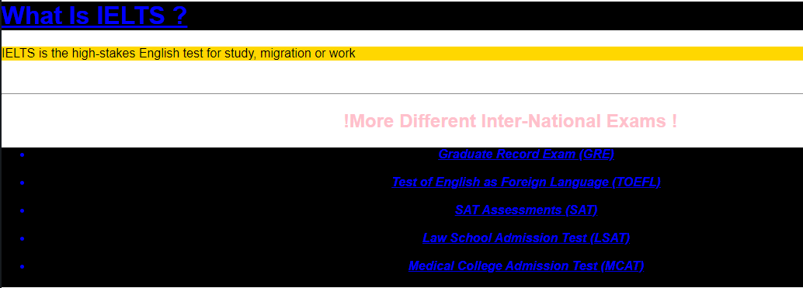

Slide 5
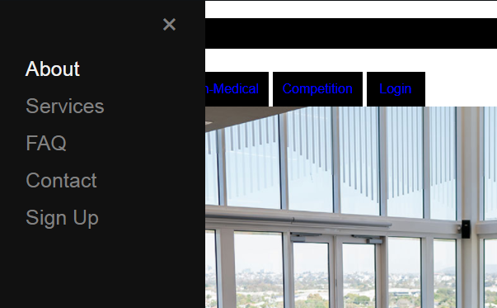

Slide 6
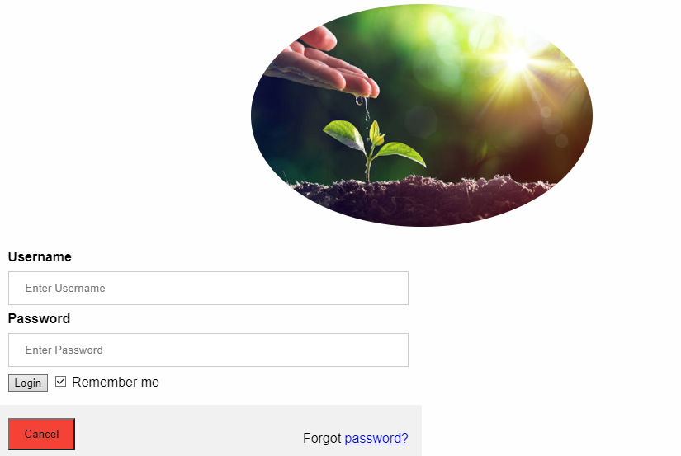

Slide 7
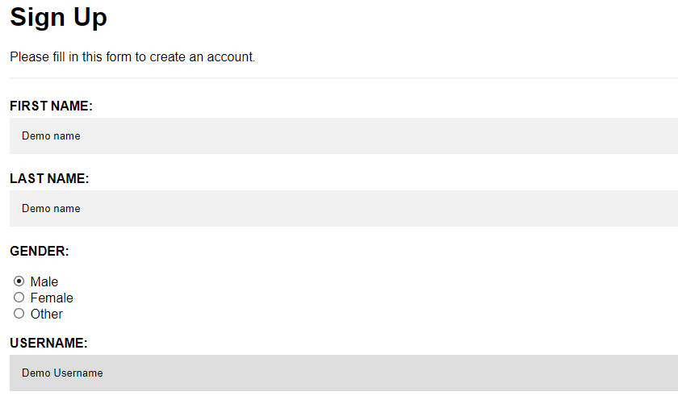

Slide 8
SOFTWARES/LIBRARIES USED
HTML
Java script(Scripting using java)
CSS
Mysql

Slide 9
Conclusion
This section discusses the results of the project. All information here is repeated from earlier sections of this report. In the end the project was successfully implemented even after facing some serious problems. My project is all about doing the sentimental analysis of a particular topic on the famous social media sites.
That is it helps in analyzing a topic or product whether it is liked by customers or not. It helps businesses makes sense of all the unstructured text by tagging it.
It is highly cost effective and helps in processing data at a large scale which reduce the work load.
It follows a consistent criteria which helps in providing results without an major problems. Therefore I will say that the sentimental analysis plays a really important role and my program helps in performing this analysis on twitter.

Slide 10
THANK
YOU

